Slide 1

CASE STUDY
Performance Evaluation of Hybrid Automatic Repeat Request (HARQ) Schemes in 5G NR under Fading Channels
Team Members:
K.AZAAN AHAMED - 23BEC0362
S.S.SREENITHIE- 23BEC0423
ADARSH- 23BML0100
WIRELESS AND MOBILE COMMUNICATIONS - BECE317L

Slide 2
1
Introduction
5G Communication Challenges
Impact on Communication Quality
Fifth-generation (5G) wireless networks demand ultra-high reliability and ultra-low latency to support critical applications including autonomous vehicles, industrial automation, and remote surgery.
These impairments cause packet errors and packet loss, directly degrading the Quality of Service (QoS) and user experience.
High Reliability: 99.999% packet delivery requirement
→
Errors → Packet Loss
Low Latency: < 1ms end-to-end delay target
→
Packet Loss → Reduced QoS
Wireless Channel Impairments
HARQ: The Solution
Hybrid Automatic Repeat Request (HARQ) combines Forward Error Correction (FEC) with Automatic Repeat Request (ARQ) to significantly improve link performance.
Noise
Interference
Fading
Thermal & interference
Co-channel & adjacent
Multipath & shadowing
FEC
+
ARQ
=
HARQ
Error Correction
Retransmission
Enhanced Reliability

Slide 3
2
SDG Goals Alignment
HARQ technology directly contributes to the United Nations Sustainable Development Goals (SDGs), enabling sustainable and inclusive communication infrastructure worldwide.
9
SDG 9
11
SDG 11
4
SDG 4
Industry, Innovation & Infrastructure
Sustainable Cities & Communities
Quality Education
Reliable Communication Systems: HARQ ensures robust data transmission for industrial IoT and smart manufacturing
Smart Connectivity: Powers IoT networks for smart city applications
Advanced Learning: Facilitates remote education and virtual classrooms
Intelligent Transport: Supports autonomous vehicles and traffic management systems
Research Collaboration: Enables seamless international academic cooperation
Infrastructure Resilience: Enables critical infrastructure monitoring and control systems
Public Safety: Enables reliable emergency communication networks
Digital Inclusion: Provides reliable connectivity for underserved regions
Technological Innovation: Drives advancement in wireless communication standards
Spectrum Efficiency Impact
HARQ enables efficient spectrum usage, maximizing data throughput while minimizing interference—critical for sustainable wireless communication growth.

Slide 4
3
Problem Statement
Key Challenges in 5G Communication
Limitations of Conventional ARQ
Traditional Automatic Repeat Request (ARQ) schemes are inefficient in poor channel conditions, discarding valuable received information and retransmitting entire packets repeatedly.
1
High Error Rates in Fading Channels
Wireless fading channels cause significant signal degradation, leading to high Bit Error Rates (BER) that compromise data integrity.
Conventional ARQ Efficiency
LOW
2
Increased Delay from Retransmissions
Poor performance in fading environments
Multiple retransmissions introduce latency, violating 5G's ultra-low latency requirements for time-sensitive applications.
Research Gap
3
Trade-off: Reliability vs Throughput
Achieving high reliability often requires sacrificing throughput, creating a fundamental optimization challenge.
There is a critical need for optimized HARQ schemes specifically designed for 5G requirements that can:
Maximize throughput while maintaining reliability
Minimize retransmission delays
Adapt to varying channel conditions
Efficiently utilize spectrum resources

Slide 5
4
Research Objectives
Primary Objective
To comprehensively analyze and compare the performance of three major HARQ schemes in 5G New Radio (NR) under realistic fading channel conditions.
Scheme Analysis
Performance Metrics
1
Type I HARQ
Bit Error Rate (BER)
Basic retransmission without combining
Measure of data integrity and reliability
Chase Combining (CC)
Lower is better
2
Signal-level combining approach
Throughput
3
Incremental Redundancy (IR)
Data rate efficiency and spectrum utilization
Code-level combining approach
Higher is better
Channel Conditions
Study behavior under Rayleigh and Rician fading channels to evaluate real-world performance across diverse wireless environments.

Slide 6
5
System Architecture
Figure 1: Complete transmission system model for HARQ performance evaluation in 5G NR.
Data
Generation
→
Channel
Encoding
→
Modulation
(QAM)
→
Fading
Channel
Rayleigh / Rician
↓
HARQ
Process
→
Decoder
(FEC)
→
Performance
Metrics
Type I / CC / IR
BER / Throughput
Fading Models
HARQ Mechanisms
Measurements
Rayleigh: No line-of-sight
Type I: Simple ARQ
BER: Error probability
Rician: With line-of-sight
CC: Signal combining
Throughput: Data rate
IR: Code combining

Slide 7
6
Methodology Overview
A comprehensive MATLAB-based simulation framework was developed to evaluate HARQ performance under controlled channel conditions.
Simulation Components
Performance Evaluation
1
Transmission System Model
BER vs SNR Analysis
Complete end-to-end communication chain
Measure bit error rate across different signal-to-noise ratios
2
Fading Channel Models
Rayleigh and Rician distributions
Throughput Measurement
Calculate effective data rate under various conditions
3
HARQ Implementations
Type I, CC, and IR schemes
Comparative Analysis
Direct comparison of all three HARQ schemes
Simulation Parameters
Channel coding: Turbo/LDPC | Modulation: 16-QAM, 64-QAM | SNR range: 0-20 dB | Maximum retransmissions: 4

Slide 8
7
Approach 1: Type I HARQ
Mechanism Overview
Key Characteristics
Type I HARQ is the simplest form of hybrid ARQ, combining Forward Error Correction (FEC) with basic retransmission. It represents the baseline approach for error recovery in wireless communication.
No Combining at Receiver
Previous transmissions are discarded—only the latest packet is used for decoding.
Operational Flow
1
Transmit encoded data packet
Independent Retransmissions
2
Receiver performs error detection (CRC)
Each retransmission is treated as an independent event with no memory of past signals.
3
If error detected → send NACK
4
Discard previous packet
5
Retransmit same data
Simple Error Detection
Uses Cyclic Redundancy Check (CRC) for error detection before FEC decoding.
Conceptual Insight
Type I HARQ provides minimal complexity but sacrifices spectral efficiency by not utilizing information from previous failed transmissions.

Slide 9
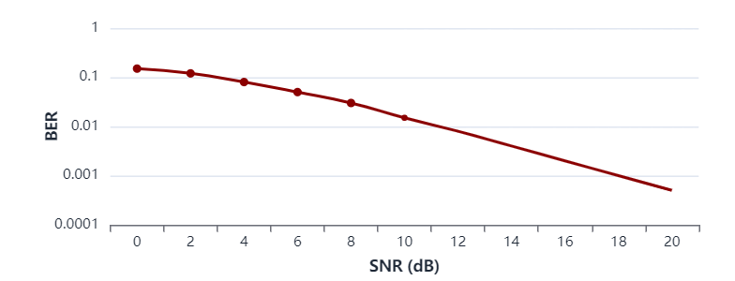
8
Type I HARQ: Analysis & Performance
Advantages
Performance Characteristics
Low Complexity
Minimal computational requirements at both transmitter and receiver
Figure 2: Type I HARQ Performance
Easy Implementation
Straightforward design with simple state machine
Low Memory Requirements
No need to store previous transmissions
Disadvantages
Poor Spectral Efficiency
Wasted bandwidth due to repeated full-packet retransmissions
Simulated BER vs SNR for Type I HARQ in Rayleigh fading channel
Higher Retransmissions
More retransmissions needed in poor channel conditions
Lower Throughput
Critical Assessment
Reduced effective data rate, especially at low SNR
High BER in fading conditions makes Type I HARQ unsuitable for 5G high data rate requirements.
BER at 10 dB SNR
Throughput Efficiency
~10⁻²
~60%

Slide 10
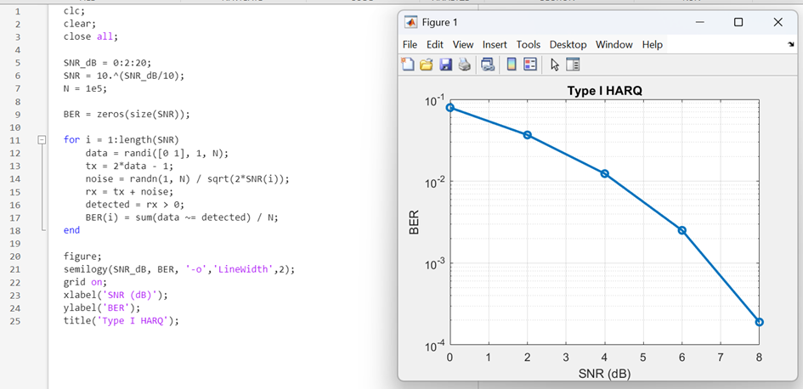
Code Link: https://drive.google.com/file/d/1dda6jJY28kotadnWUhL9A8lzhUtEJBAd/view?usp=sharing

Slide 11
SECTION 4.1
9
Approach 2: Chase Combining (CC)
Mechanism Overview
Core Concept: Signal Energy Accumulation
Chase Combining (CC) improves upon Type I HARQ by combining multiple received copies of the same packet, accumulating signal energy to enhance detection reliability.
Each retransmission adds coherent signal energy while noise adds incoherently, improving the effective SNR.
Equation 1: Combined SNR
Operational Flow
SNRtotal = SNR₁ + SNR₂ + ... + SNRn
1
Transmit encoded data packet
2
If error → send NACK
3
Store previous signal in buffer
Maximum Ratio Combining (MRC): Optimal linear combining technique
4
Retransmit same encoded packet
Soft Combining: Operates at signal level before decoding
5
Combine all copies using MRC
Same Redundancy: Identical parity bits in each retransmission
Conceptual Insight
CC provides diversity gain by exploiting multiple independent fading realizations, significantly improving reliability in time-varying channels.

Slide 12
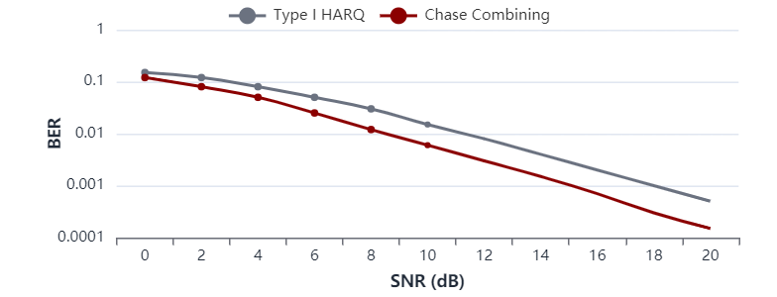
10
Chase Combining: Analysis & Performance
Advantages
Performance Characteristics
Improved Reliability
Significantly better than Type I HARQ
Figure 3: Chase Combining Performance
Better SNR Performance
Effective SNR increases with each retransmission
Diversity Gain
Exploits time diversity in fading channels
Disadvantages
Increased Memory
Requires buffer storage for soft decisions
Simulated BER vs SNR comparison: Type I vs Chase Combining
Moderate Complexity
MRC operations add computational overhead
Same Code Rate
Performance Summary
No coding gain improvement
BER at 10 dB SNR
Throughput Efficiency
~10⁻³
~75%
Reduced BER and moderate throughput improvement over Type I HARQ.

Slide 13
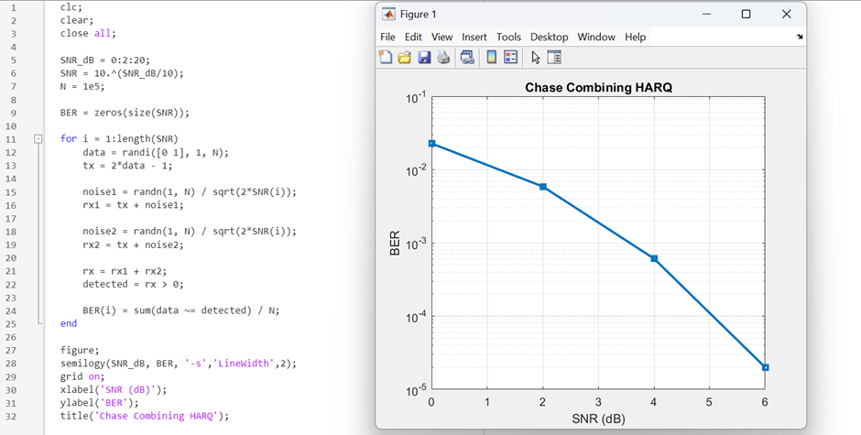
Code Link : https://drive.google.com/file/d/1kU1ZefZHrEepkwp1Bvz3mE7fPYl0F24M/view?usp=sharing

Slide 14
11
Approach 3: Incremental Redundancy (IR)
Mechanism Overview
Core Concept: Gradual Redundancy Increase
Incremental Redundancy (IR) represents the most advanced HARQ scheme, transmitting different parity bits in each retransmission to gradually increase coding redundancy and improve error correction capability.
Each retransmission adds new parity information, effectively lowering the code rate and increasing error correction capability.
1st Transmission:
Code Rate R = 1/2
Operational Flow
2nd Transmission:
Code Rate R = 1/3
1
Transmit initial coded packet
2
If error → send NACK
3rd Transmission:
Code Rate R = 1/4
3
Store received packet
4
Retransmit different parity bits
Soft Combining: Operates at code level with advanced decoding
5
Combine all transmissions for decoding
Coding Gain: Additional gain from code combining
Rate Compatibility: Uses rate-compatible punctured codes
Conceptual Insight
IR provides both diversity gain (like CC) and coding gain, achieving the best error performance among all HARQ schemes.

Slide 15
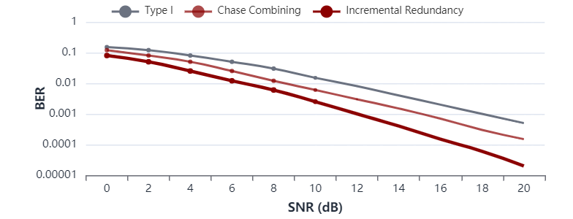
12
Incremental Redundancy: Analysis & Performance
Advantages
Performance Characteristics
Best Error Performance
Lowest BER among all HARQ schemes
Figure 4: Incremental Redundancy Performance
High Throughput
Optimal spectrum utilization
Efficient Bandwidth Usage
Different parity bits maximize information
Coding + Diversity Gain
Both types of gain combined
Disadvantages
Simulated BER comparison: All three HARQ schemes
High Complexity
Advanced encoding/decoding required
Advanced Coding Required
Performance Summary
Needs rate-compatible codes (Turbo/LDPC)
Higher Memory
BER at 10 dB SNR
Throughput Efficiency
Store multiple different transmissions
~10⁻⁴
~85%
Lowest BER and best overall performance—ideal for 5G applications.

Slide 16
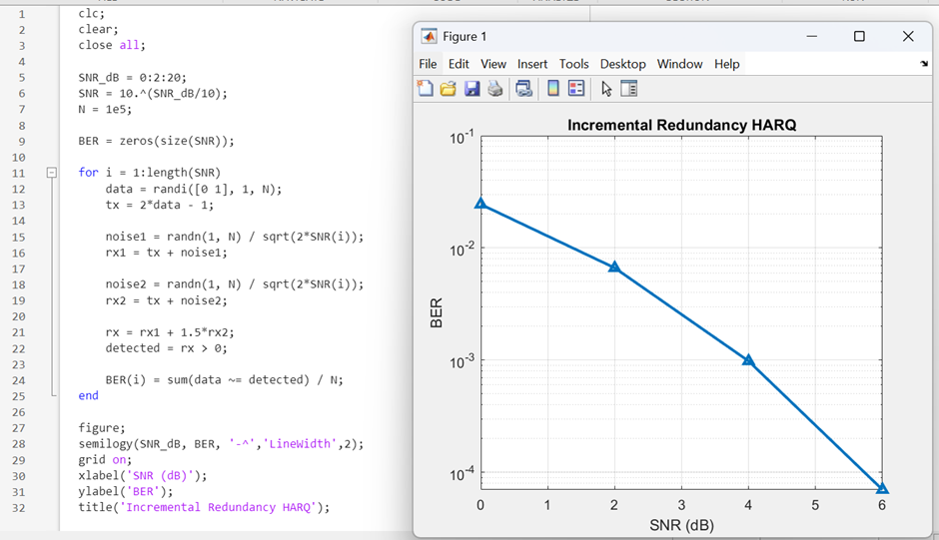
Code Link: https://drive.google.com/file/d/1CXkximxC0kV0OQwOXhVA5ePVRsdiFDlN/view?usp=sharing

Slide 17
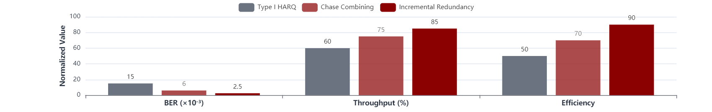
13
Comparative Results & Discussion
BER Performance
Throughput
Retransmissions
Lower is Better
Higher is Better
Lower is Better
1. Incremental Redundancy
BEST
1. Incremental Redundancy
BEST
1. Type I HARQ
HIGHEST
2. Chase Combining
GOOD
2. Chase Combining
GOOD
2. Chase Combining
MODERATE
3. Type I HARQ
POOR
3. Type I HARQ
POOR
3. Incremental Redundancy
LOWEST
Figure 5: Comprehensive Performance Comparison
Key Observations
IR performs best under fading conditions with coding + diversity gain
CC provides balance between complexity and performance
Type I is least efficient but simplest to implement

Slide 18
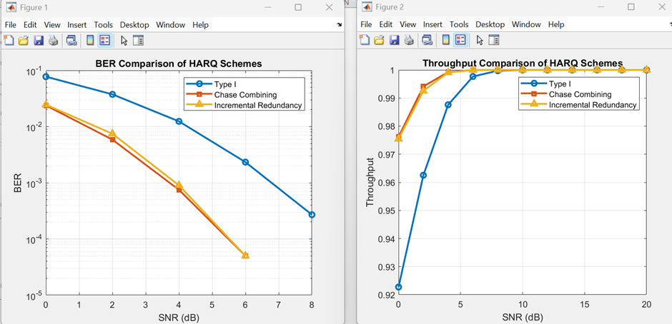
Code Link: https://drive.google.com/file/d/1zRtiz0Se1VHyuoPNnd8NCS2iN9XQrdyF/view?usp=sharing

Slide 19
14
Applications of HARQ in 5G
HARQ schemes are fundamental to enabling diverse 5G use cases, from ultra-reliable low-latency communications to massive machine-type communications.
5G NR Systems
Mobile Broadband
IoT Networks
Core component of 5G New Radio (NR) physical layer, ensuring reliable data transmission across all deployment scenarios.
Powers high-speed mobile internet with consistent quality of service for streaming, gaming, and cloud applications.
Enables massive IoT connectivity with efficient spectrum usage for smart sensors and industrial monitoring.
• Enhanced Mobile Broadband (eMBB)
• 4K/8K video streaming
• Smart city infrastructure
• Ultra-Reliable Low Latency (URLLC)
• Cloud gaming services
• Industrial IoT (IIoT)
• Massive Machine Type (mMTC)
• Augmented/Virtual reality
• Environmental monitoring
Autonomous Vehicles
Real-Time Services
Critical for V2X communications requiring ultra-reliable, low-latency data exchange for safety-critical decisions in self-driving cars.
Supports video conferencing, live streaming, and online gaming with minimal buffering and consistent quality under varying channel conditions.

Slide 20
15
Advantages & Limitations
Advantages of HARQ
Limitations of HARQ
Improved Reliability
Increased Latency
Significantly reduces packet errors through intelligent retransmission and combining techniques, achieving 99.999% reliability targets.
Retransmissions introduce delays that can violate ultra-low latency requirements for time-critical applications.
Reduced Packet Loss
Implementation Complexity
Combining multiple transmissions maximizes the probability of successful decoding, minimizing data loss in poor channel conditions.
Advanced schemes (especially IR) require sophisticated encoding/decoding algorithms and rate-compatible code design.
Adaptive Error Control
Memory Requirements
Automatically adapts to channel conditions—fewer retransmissions in good channels, more robust combining in poor channels.
CC and IR schemes need substantial buffer storage at the receiver to store soft decisions and multiple transmissions.
Spectrum Efficiency
Power Consumption
Optimal use of available bandwidth through intelligent redundancy management, especially with IR schemes.
Additional processing for combining and advanced decoding increases energy consumption in mobile devices.

Slide 21
16
Future Research Directions
The evolution of HARQ technology continues with emerging research areas that promise to further enhance wireless communication performance.
AI-Based HARQ Optimization
Adaptive HARQ Schemes
Leveraging machine learning algorithms to optimize retransmission strategies based on real-time channel conditions and traffic patterns.
Developing context-aware HARQ that dynamically switches between Type I, CC, and IR based on application requirements and channel state.
• Predictive retransmission scheduling
• Service-specific optimization
• Dynamic code rate adaptation
• Cross-layer design approaches
• Intelligent combining strategies
• QoS-aware retransmission control
Integration with 6G
ML for Channel Prediction
Designing next-generation HARQ for 6G requirements including terahertz communications and intelligent reflecting surfaces.
Using deep learning models to predict channel conditions and proactively adjust HARQ parameters before degradation occurs.
• THz band communication support
• LSTM-based channel forecasting
• Massive MIMO integration
• Reinforcement learning for HARQ
• Semantic communication paradigms
• Real-time parameter optimization
Research Impact
These research directions aim to achieve near-zero latency and 99.99999% reliability for next-generation wireless applications.

Slide 22
17
Conclusion
Key Findings
This study comprehensively evaluated three HARQ schemes for 5G NR, demonstrating that HARQ is essential for achieving 5G reliability targets in fading channel environments.
1
Type I HARQ
2
Chase Combining
3
Incremental Redundancy
✓ Simple
✓ Balanced
✓ Best performance
✗ Inefficient
✓ Moderate complexity
✗ Higher complexity
Best for resource-constrained devices requiring minimal complexity.
Ideal for general-purpose applications requiring good performance.
Optimal for 5G high-data-rate and mission-critical applications.
Fundamental Trade-off
The choice of HARQ scheme involves a fundamental trade-off between complexity and efficiency. Application requirements, channel conditions, and device capabilities must be carefully considered to select the optimal approach.
Best Overall Performance
Path Forward
Incremental Redundancy delivers the best BER and throughput performance, making it the preferred choice for 5G NR deployment.
Future research should focus on AI-driven adaptive HARQ and integration with emerging 6G technologies.
Thank You for Your Attention

Slide 23
I8
References
1 ) Throughput and Delay Analysis of HARQ with Code Combining over Double Rayleigh Fading Channels -
https://drive.google.com/file/d/1N-OrEkbxuYs4QRwbdTpeMklnE2wDYdli/view?usp=sharing
2) Resource Allocation and HARQ Optimization for URLLC Traffic in 5G Wireless Networks
https://drive.google.com/file/d/1PMNAJSdlmasz_vWRyERSJZXWKQkN21Ks/view?usp=sharing
3) Optimized Asymmetric Feedback Detection for Rate-adaptive HARQ with Unreliable Feedback
https://drive.google.com/file/d/1Qx2NJsd29xjYSvTMBcHu1JMaYZAcl1BZ/view?usp=sharing
4) URLLC for 5G and Beyond: Requirements, Enabling Incumbent Technologies and Network Intelligence
https://drive.google.com/file/d/18ZLKuHUWLrPDFYnw_WdtTpKi9yQad_Qj/view?usp=sharing
5) Performance Evaluation of 5G New Radio LDPC over Different Scenarios of Lognormal Fading Channel
https://drive.google.com/file/d/1YbbMUDmyaAqTGB-pGvnqG1AITd0fjF1F/view?usp=sharing

